Slide 1
Using version control and git
A lab book for your code
Notes:
General outline:
Spend 10 minutes on intro (up to slide 10)
Spend 15 minutes on slides on setting up git and commiting
Spend 20 minutes going through the script
Spend 10 minutes on the first exercise
Spend 5-10 minutes discussing GUIs
BREAK + 2nd exercise (15 minutes)
Spend 20 minutes discussing remote repositories
Spend 15 minutes discussing branches
Spend 10 minutes discussing other features and resources

Slide 2
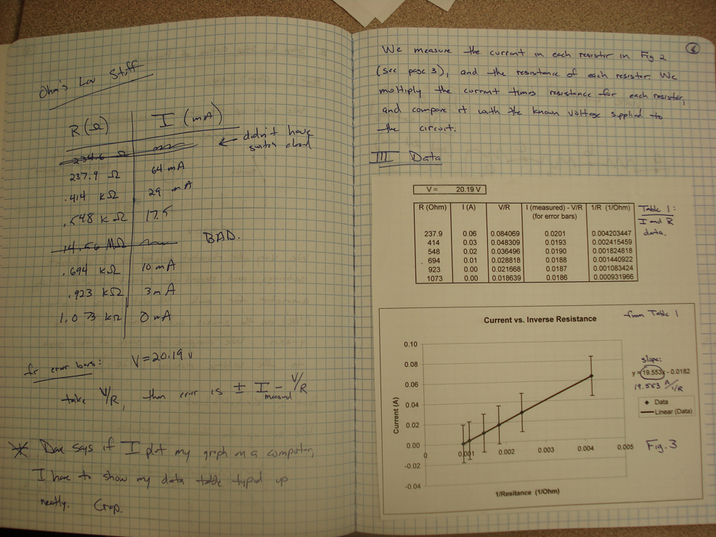
The lab book has many purposes:
Reminds you of what you’ve done
Lets you go back to change something that went wrong
Lets other people reproduce your work or pick up where you left off
Serves as proof that the work was done
Why do many people stop when it comes to writing code?

Slide 3
The lab book has many purposes:
Reminds you of what you’ve done
Lets you go back to change something that went wrong
Lets other people reproduce your work or pick up where you left off
Serves as proof that the work was done
Why do many people stop when it comes to writing code?

Slide 4
Keeping track of changes in your analyses
When working in R (or Matlab, or Mathematica, or ….etc.) you generally save code as scripts
How do we keep a lab book for our code?

Slide 5
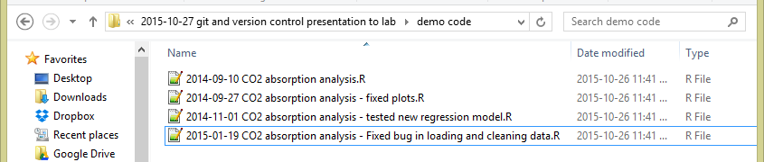
1. Keep each version of a file as you change it
Pros: keeps each version of your code, so you can recreate it if something doesn’t work
Cons: Adds up to a lot of extra files. Really easy to forget to save a new version, or end up with “version_1_clean”, “version_1_better”, “version_2_cleaned_again” ….

Slide 6
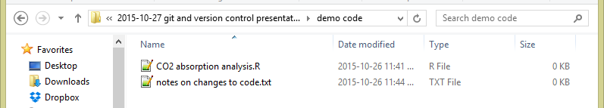
2. Keep notes on changes as a separate file (or as a paper lab book)
Pros: Keeps your folder clean (each file does a specific thing). Notebook will keep track of why you made each change over time
Cons: You can never go back and recreate an old analysis. Really easy to forgot to write a change down in your lab book…

Slide 7
3. Best of both worlds: Software version control
Keeps track of:
What files have changed over time, and what the changes are
What files have changed that have yet to be stored
Lets you:
Keep detailed notes on why you made each change
Revert back to old versions of code if needed
Try experimental changes without risking code that works
Share your code and history of changes easily

Slide 8

What is , and why use it?
One type of version control software (likely the most popular), invited in 2005
Free and open source
Easy to set up on a personal computer
Lot of great support tools (including support within Rstudio) and a huge and helpful user base
Can put things on GitHub (more about this in the second half)

Slide 9
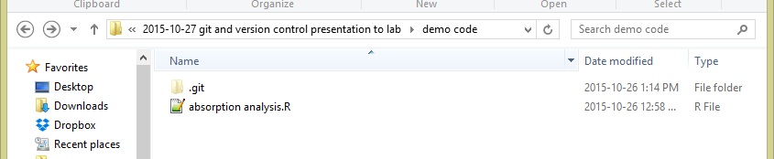
What is , and why use it?

Slide 10
What I’ll cover today:
How to set up a git repository for a project (the “lab book”)
Tracking files with commits and comments
Slightly more advanced (in the second half)
Collaborating using local and remote repositories
Going back in time with branches
Other useful tricks

Slide 11
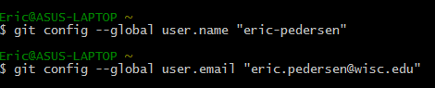
Setting up git
Open up a command line terminal (git bash on Windows, terminal on Mac) and type in the following two lines (using your own name and email):

Slide 12
Creating a repository:
File_1
File_1
File_2
File_2
.git folder
Project folder
This tells git to keep track of what’s changed in this folder

Slide 13
Staging and committing
Modified
Untracked
staged
Unmodified
Notes:
Untracked: new files that have been added
Staged: can hold as many file

Slide 14
Staging and committing
Modified
add
Untracked
staged
add
You change
some files
commit
Remove the file
Unmodified

Slide 15
Staging and committing
Modified
Untracked
staged
File_1
add
File_2
git -add “File_1” “File_2”
Unmodified

Slide 16
Staging and committing
Modified
Untracked
staged
File_1
File_2
commit
git commit –m “my first commit. Hello World”
Unmodified

Slide 17
The second basic process: Staging and committing
Modified
Untracked
staged
Commit 1:
“My first commit. Hello world.”
File_1
File_2
Unmodified

Slide 18
Let’s view this in code
Open up a console
On Windows: Press start, the search “git bash”
On Mac: Use the finder to search “terminal”
Open the script file I sent

Slide 19



Using git from a GUI
It’s hard to remember all of these commands….
Fortunately: there’s a lot of tools out there to make it easier!
Unfortunately: there’s a lot of tools out there…
Notes:
R studio pros: open source, lets you integrate your R workflow with your git workflow. Easy setup. Downsides: not as stable all of the time (still in relatively early development) and you have to set up an R package to be able to use it. It also doesn’t have all of the features of the other ones, so you’d have to go back to command line more often. It’s also still in very active development.
Sourcetree pros: free, efficient, works on all platforms (Mac, PC, Linux), very feature rich. Doesn’t need a Github account to set up. Cons: I find it a bit unstable at times. It’s not open source
GitKraken: pros: same as Sourcetree, and it’s more stable. Cons: Need a Github account to get started, can be a bit slow to load.

Slide 20
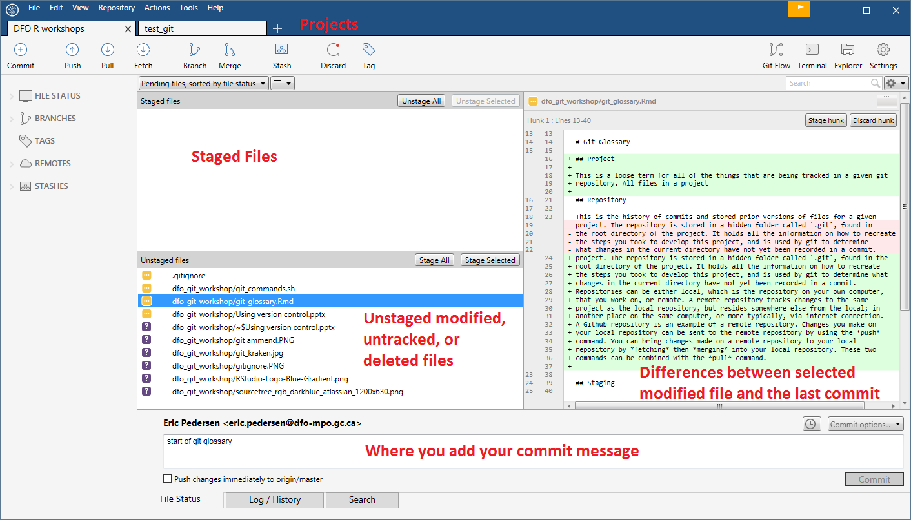

Slide 21
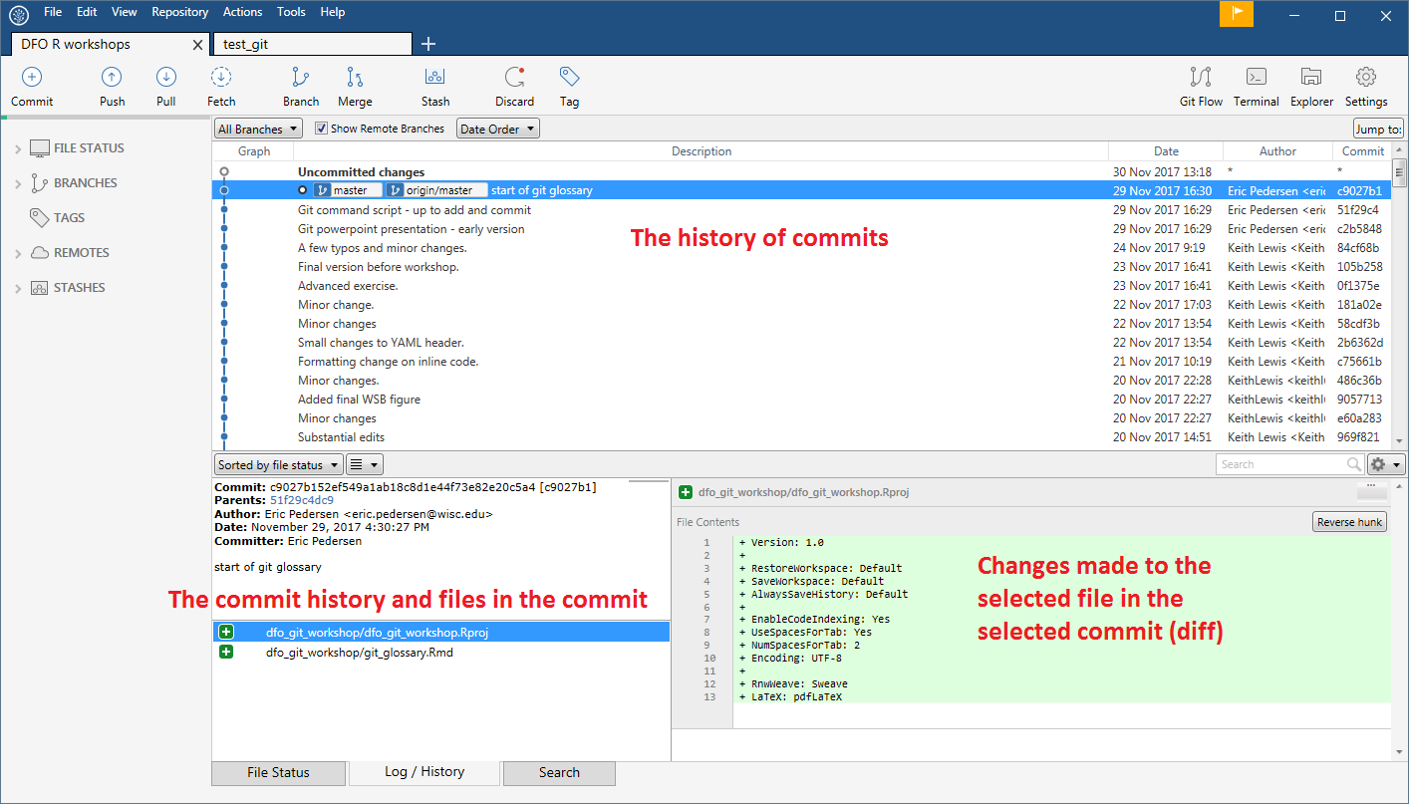

Slide 22
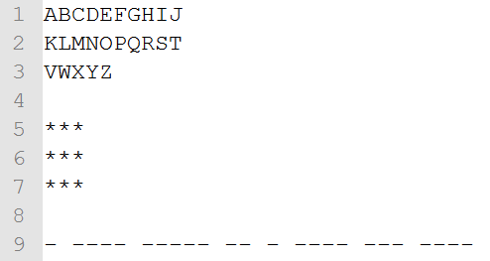
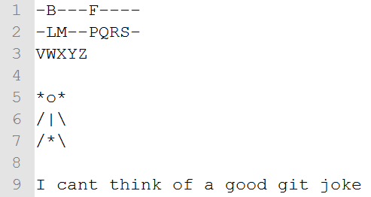
Exercise: Practicing git (15 minutes)
With a partner: Create a new repository, and play Hangman, tracking each change of the game with a commit
Try using both the command line and Sourcetree
Initial setup
Final game

Slide 23
Break
(10 minutes)

Slide 24
Slightly more advanced topics:
Branching
Remote repositories (aka: collaborating with Github!)
Useful git tricks

Slide 25
Working with remote repositories (how do you collaborate with git?)
Your collaborator’s
computer
Your computer
File_1
File_1
?
File_2
File_2
.git folder
.git folder

Slide 26
Working with remote repositories (how do you collaborate with git?)
Your collaborator’s
computer
Your computer
push
File_1
File_1
File_2
File_2
.git folder
.git folder
pull
(or fetch+merge)
local repository
Remote repository

Slide 27
Working with remote repositories (how do you collaborate with git?)
Your collaborator’s
computer
Github
Your computer
push
push
File_1
File_1
File_1
File_2
File_2
File_2
.git folder
.git folder
.git folder
pull
pull
Your local repository
Remote repository
Their local repository

Slide 28
Git workflow when collaborating with an existing project
Make your changes to the code
git add
git commit
Create a local copy of the repository by cloning
Check for changes on the remote branch
Commit them to your local repository
git clone <url>
git pull
Push the changes to the remote
git push

Slide 29
A quick demo of working with a remote repository

Slide 30
Branches
Used to test new ideas without changing your main analysis
A1CD4B
“developed
model”
86AB17
“Added line plots to assessment”
1476B5
“Generated predictions”
EF35B2
“made line plot of
predictions”
34A3E9
“Created histogram of predictions”
86AB17
“Added histogram to assessment”

Slide 31
Branches

Slide 32
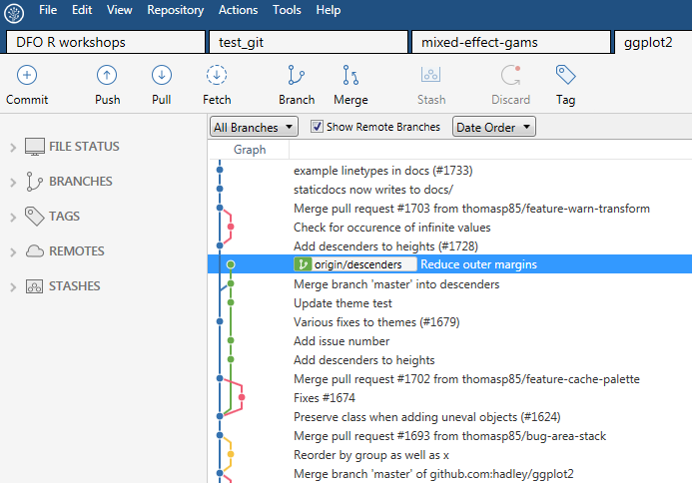
Branches

Slide 33
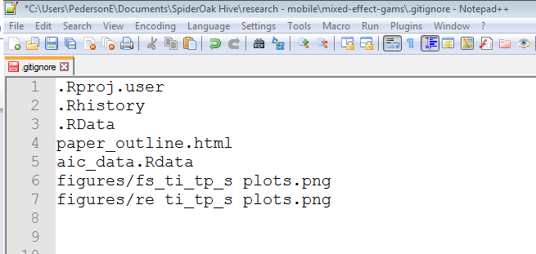
Useful tricks
.gitignore files: file you can put in a directory to tell git to ignore

Slide 34
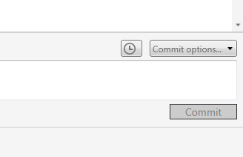
Useful tricks
Amending the last commit: lets you add new files, change files that have already been committed, or change the commit message for the last commit
git commit –amend

Slide 35
Useful tricks
Stashing current versions of files
Great for saving changes temporarily that you don’t want to lose when you fetch from a remote or switch branches in a project

Slide 36
Further resources:
The git webpage has pretty extensive manuals and tutorials on these and more advanced concepts, as does Atlassian, SourceTree’s maker:
https://git-scm.com/documentation
https://www.atlassian.com/git/tutorials/
Software Carpentry has a great tutorial:
https://swcarpentry.github.io/git-novice/
Social media (Stack Overflow, or Twitter)
e.g.: https://twitter.com/ericJpedersen/status/658719435004473344
When things (inevitably) go wrong:
http://ohshitgit.com/

Slide 37
Git tips
All the files you want to track need to be in one directory (but they can be in nested directories in that one)
Start by creating a repository for a project
Commit files early and often, in small batches
Use informative commit messages
Use branches to test new ideas
Git isn’t a backup! Always keep your backups up to date
Git will keep a copy of every form of the file you remember to stage and commit, unless you actively work to delete it. (It’s good at compression and avoiding duplication though). Use a .gitignore file if you have temporary files that you don’t want to track.
To share code, you can zip the directory and email it, or upload it to Github: both ways, your collaborator can see everything you’ve tried

